Slide 1
GOOD MORNING!
Rodel Roven C. Dacanay

Slide 2
Directions
This Topic will help us:
Direct people correctly
Give instructions to people & tourist
Guide people who are lost in the city

Slide 3

Directions

Slide 4
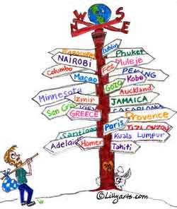


Directions
Frequently asked questions:
Where am I now?
Where do tourists go in Hua-Hin?
How can I cross the road?
How can I go to________?
Where can I get a taxi?

Slide 5

Directions: Prepositions

Slide 6
Directions: Prepositions

Slide 7
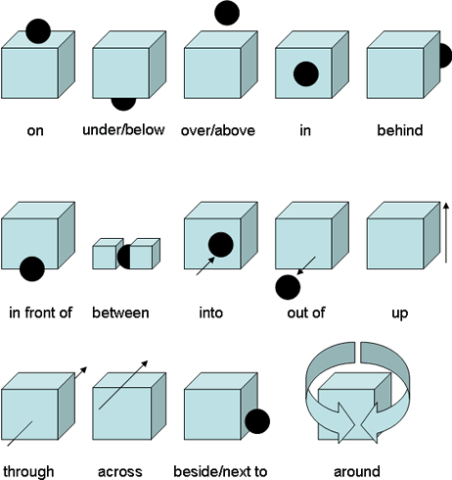
Directions: Prepositions

Slide 8
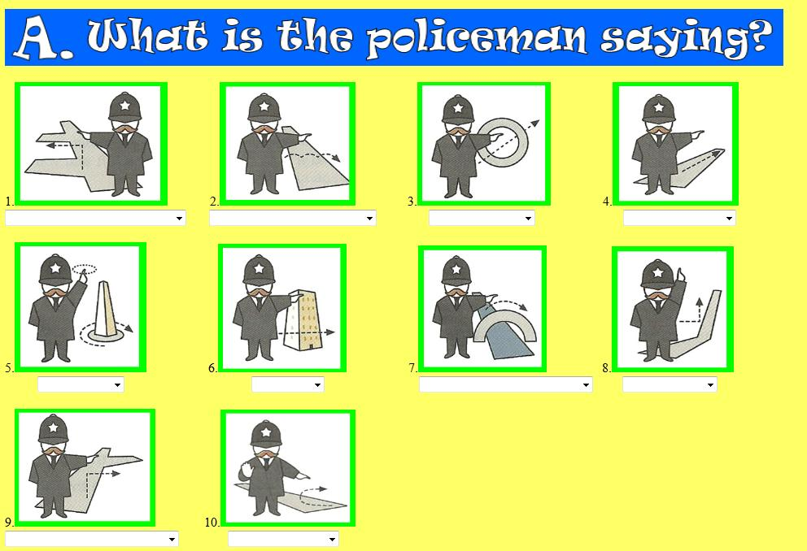
Directions: Prepositions

Slide 9
Directions: Prepositions
Basic Conversation sentences
Where am I now?
A: You are in Hua-hin city.
Where do tourists go in Hua-Hin?
A: They all want to go to the beach.
How can I cross the road?
A: You can take the over pass there.
Where can I get a taxi?
A: you can go at the corner of the street.

Slide 10
Directions: Prepositions
Basic Conversation sentences
Where is the toilet?
A: Go outside turn left and then the first door is the toilet.
How can I go to the mall?
A: Go straight turn left and the mall will be on the 5th street.
How can I go to the hospital
A: you can call 911 for an ambulance.

Slide 11

Directions: Prepositions
TIME FOR A TEST!!!

Slide 12
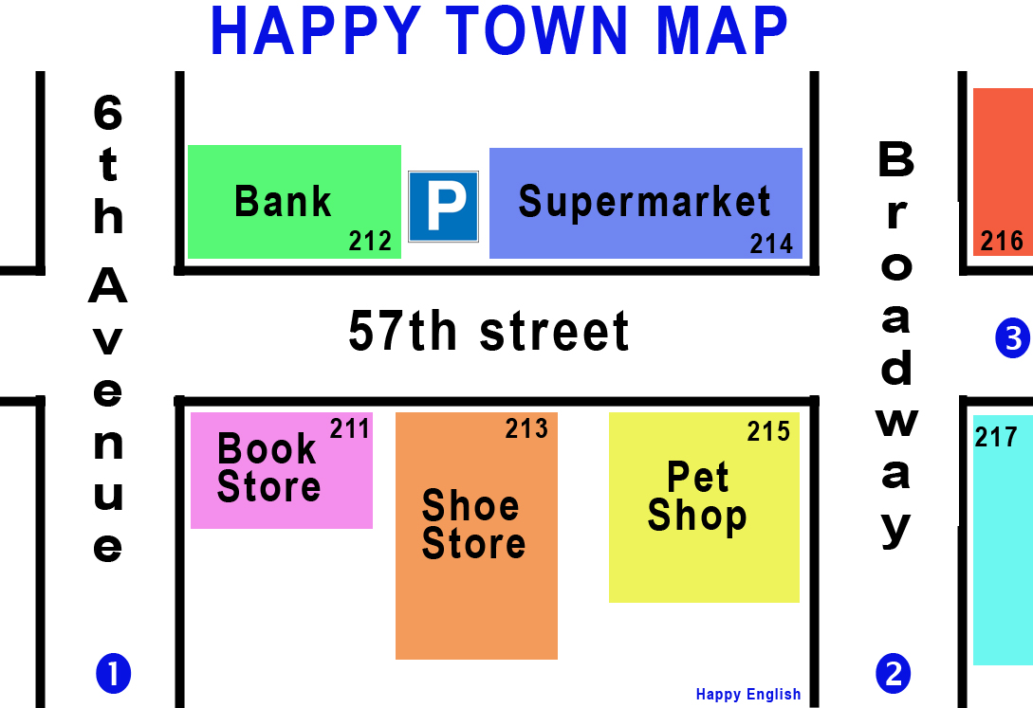
Directions: Prepositions

Slide 13
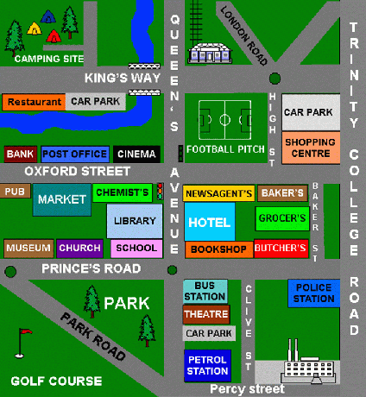
Directions: Prepositions

Slide 14
END OF LESSON
THANK YOU FOR YOUR TIME

