Slide 1
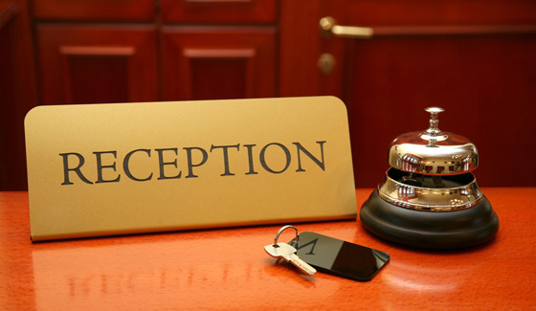
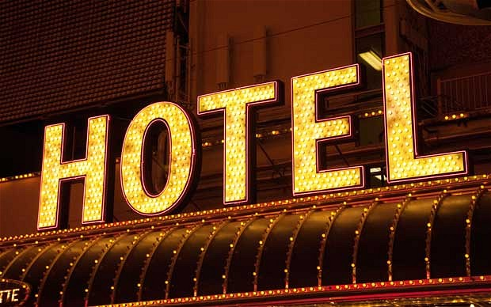
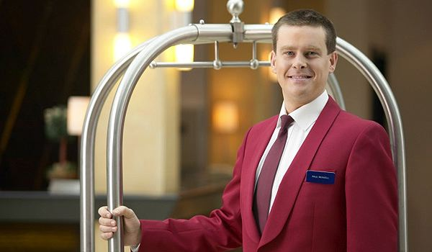
May 2014
Based on “Be My Guest”
Written by: Francis O’Hara
Cambridge University Press

Slide 2
I’ll see to it immediately.
What problems do guests have in their rooms?
Do they have problems with TV, air-conditioning, heating, noise? What kinds of items do they forget to bring with them? Do they remember to bring shaving materials, nightgowns, hair dryers, etc?

Slide 3
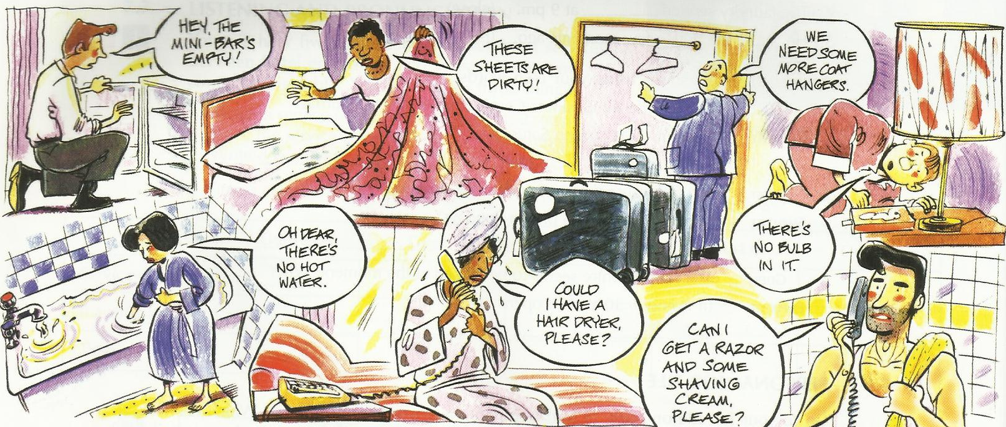
Can you think of any others?

Slide 4
Listening and pronunciation
Listen to five conversations between guests and hotel employees and match each guest and their problem.
Guest 1 guest forgets razor and shaving cream
Guest 2 sheets are dirty
Guest 3 mini-bar is empty
Guest 4 guest needs a hair dryer
Guest 5 not enough hot water
no bulb in bedside lamp
more coat-hangers are needed

Slide 5
Be clear and polite

Slide 6
Language Focus and Practice
Solutions notice how the employee offers a solution to the guests’ problem. The future with ‘will’ is used for a decision made at the time of speaking.
I’ll send someone up right away.
(to send a person to a room)
I’ll see to it immediately.
(to do something, to act)
I’ll contact housekeeping now.
(to call, tell, inform someone)
I’ll get someone to bring some up.
(to tell someone to do something)

Slide 7
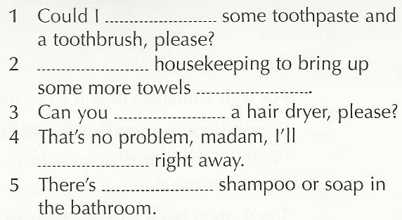
Complete these sentences using the correct words from the list.
have, send one up, some more, send up, no ,right away, contact them, I’ll get, ask, provide

Slide 8
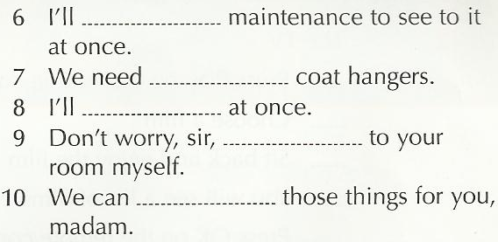
Complete these sentences using the correct words from the list.
have, send one up, some more, send up, no ,right away, contact them, I’ll get, ask, provide

Slide 9
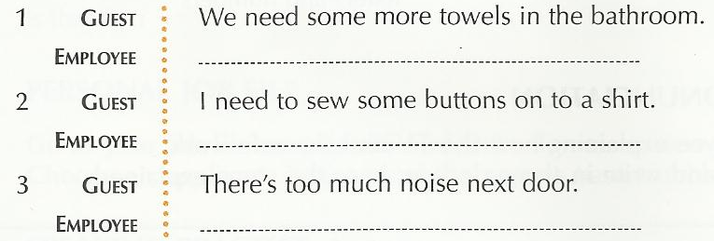

Slide 10
Personal Job File
Go to your job file and write down any new words and phrases.
What problems do guests have in the hotel where you work?
Note down a problem and the solution you would suggest.

Slide 11
You can choose your own code number for the safe.
What kind of problems do guests have with the amenities in the room?
Do guests have problem operating the TV or using the safe?
Here are two jumbles explanations. What do you think the correct order is? There are more than one possibility.

Slide 12
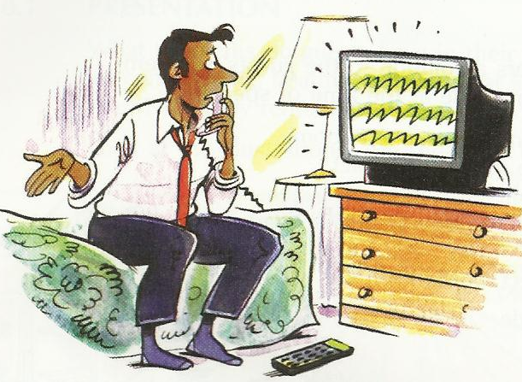
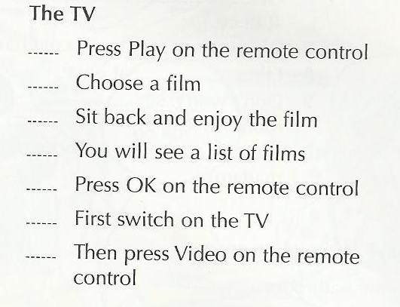

Slide 13
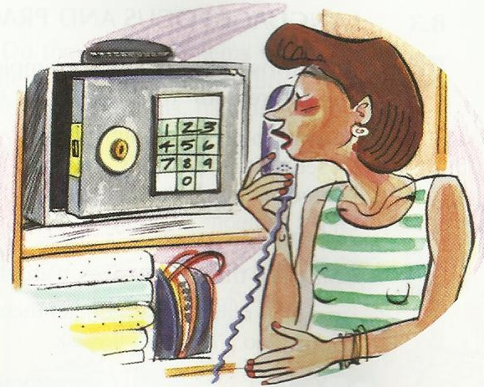
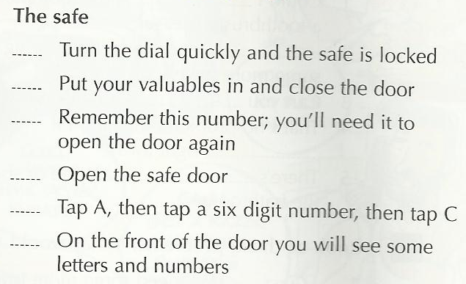

Slide 14
Listening and pronunciation
Listen to a hotel employee explaining how TV and the safe work.
Follow the instructions and write in the order you hear the steps explained.

Slide 15
Language Focus and Practice
Explaining how it works
Study these verbs. How many do you know?
Turn on Turn off
Turn up Turn down
Press Tap in
Key in Choose
Open Close
Put in Take out
example
Tap in
Tap in the code number.

Slide 16
What verbs would you use to explain how these things work?
From the list in 1 choose at least three verbs for each object.
The first has been done for you.

Slide 17
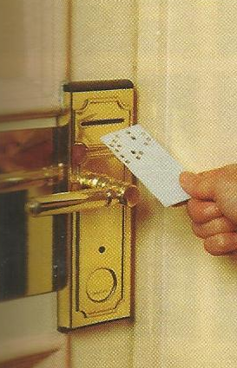
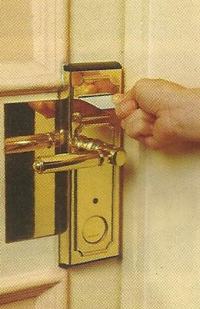
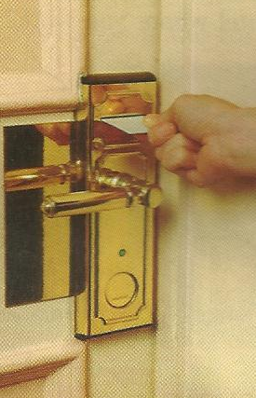
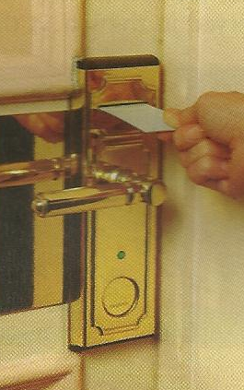
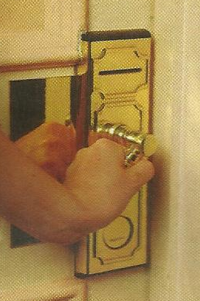
Explain how the key works.
Begin like this:
I will show you, it works like this.
First……………………………………………………………..
Then …………………………………………………………….
Is that ok?

Slide 18
Personal Job File
Go to your job file and write down any new words and phrases. Choose an appliance in the hotel that guests have trouble with. Explain how it works.

Slide 19
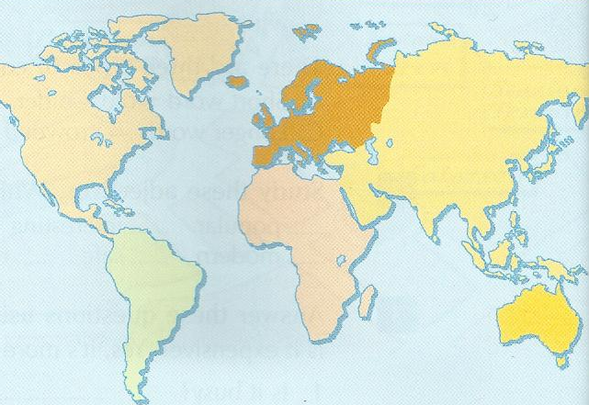
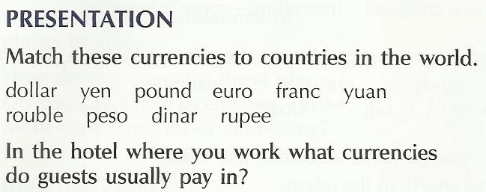

Slide 20
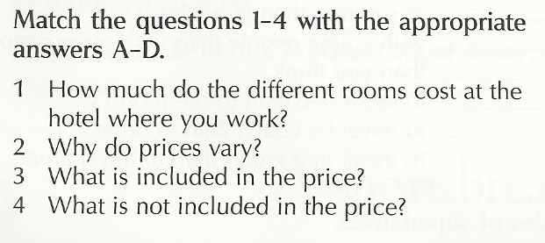
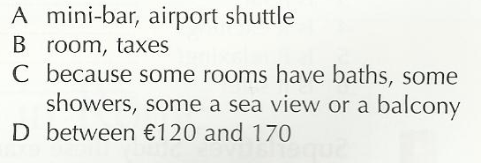

Slide 21
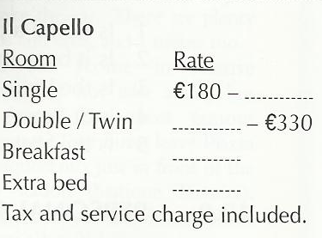
Listening and pronunciation Three guests telephone three different hotels to enquire about room rates. Listen to the three conversations and complete the gaps.
The Devonshire Arms
Room Rate
Single ₤……..
Twin single occupancy (superior) ₤95
Suite ₤………
Rates are per room, per night and include full…..and……
The stars Hotel
Room Rate
Single US$ 220-250
Double/Twin US$ ……-…..
Suite US$ 550-…….
A……… service charge applies to the above rates.

Slide 22
Listening and circle the numbers you hear.
4 14 19 29 33
50 66 76 80
100 240 330
450 600 740
820 901 1,000

Slide 23
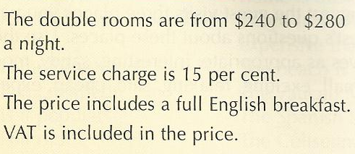
Being clear and polite listen to these sentences and repeat them.

Slide 24
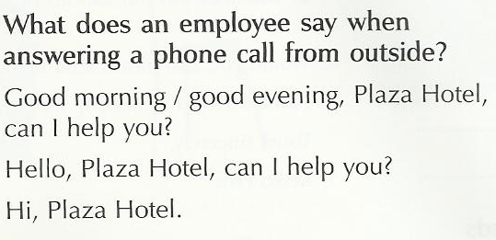
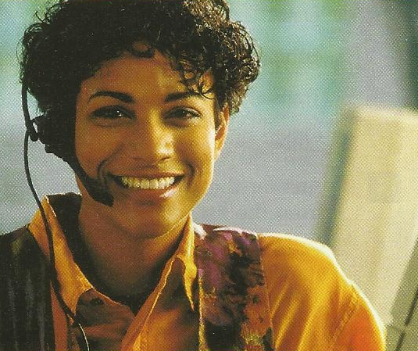
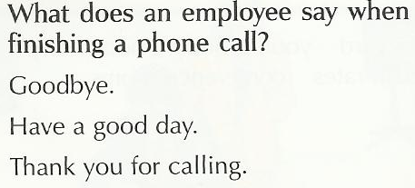
Good morning, Plaza Hotel, can I help you?

Slide 25
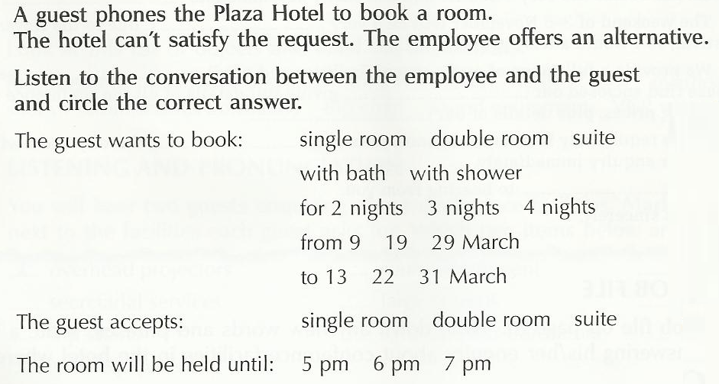
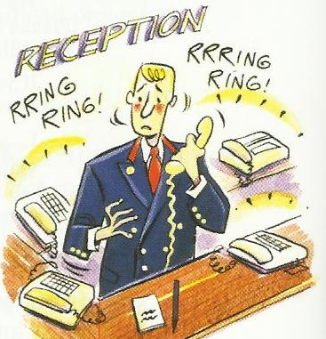
Listening and Pronunciation

Slide 26
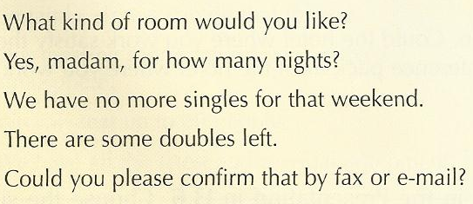
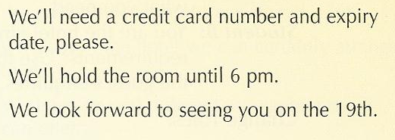
Being clear and polite listen to these sentences and repeat them.

Slide 27
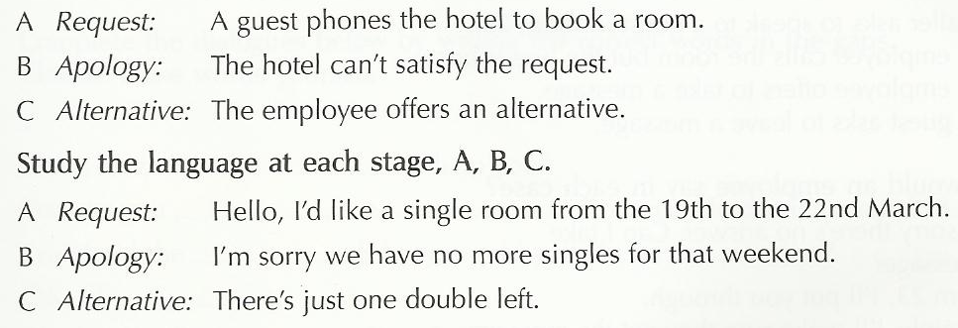
Language Focus and Practice
Building the conversation
A guest phones to book a room. The employee apologizes as the hotel can’t satisfy the request, and then offers an alternative. Study the three stages, A, B, C.

Slide 28
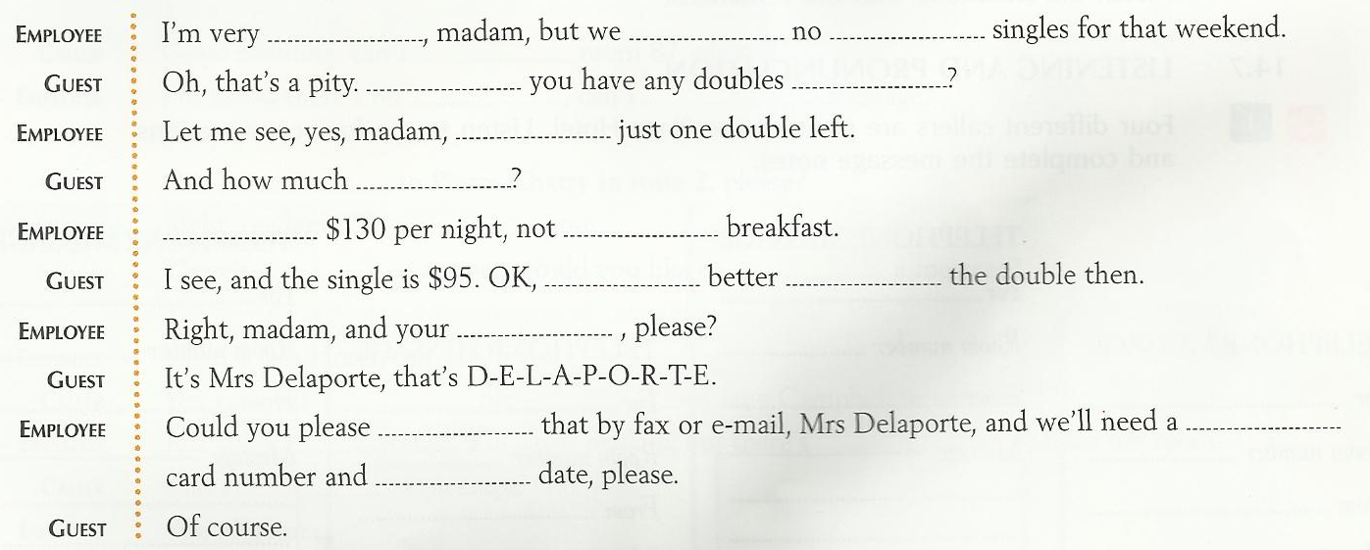

Slide 29
Personal Job File
Go to your job file.
Write down any new words and phrases.
Write down how you begin, and end a telephone conversation in the hotel where you work. Write a brief conversation between a hotel employee and guest, where the hotel can’t offer the guest what they want, but have an alternative.

Slide 30
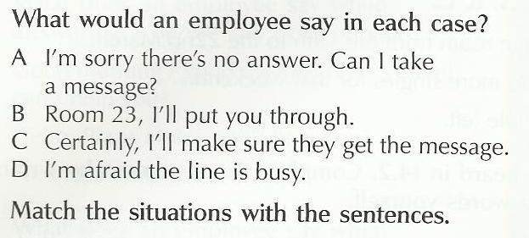

Slide 31
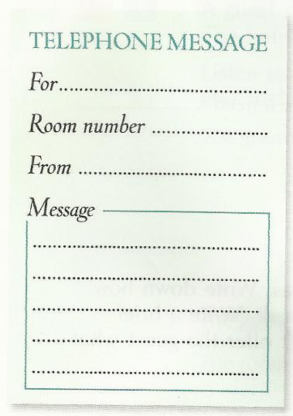
Listening and Pronunciation
Four different callers are phoning the Plaza Hotel.
Listen to the four conversation and complete the message note.

Slide 32
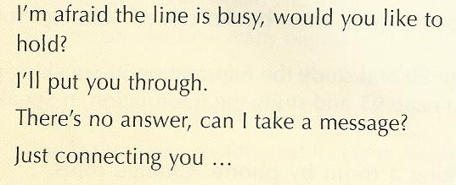
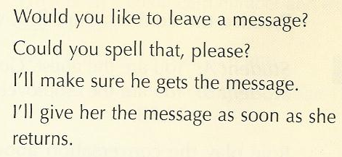
Being clear and polite listen to these sentences and repeat them.

Slide 34
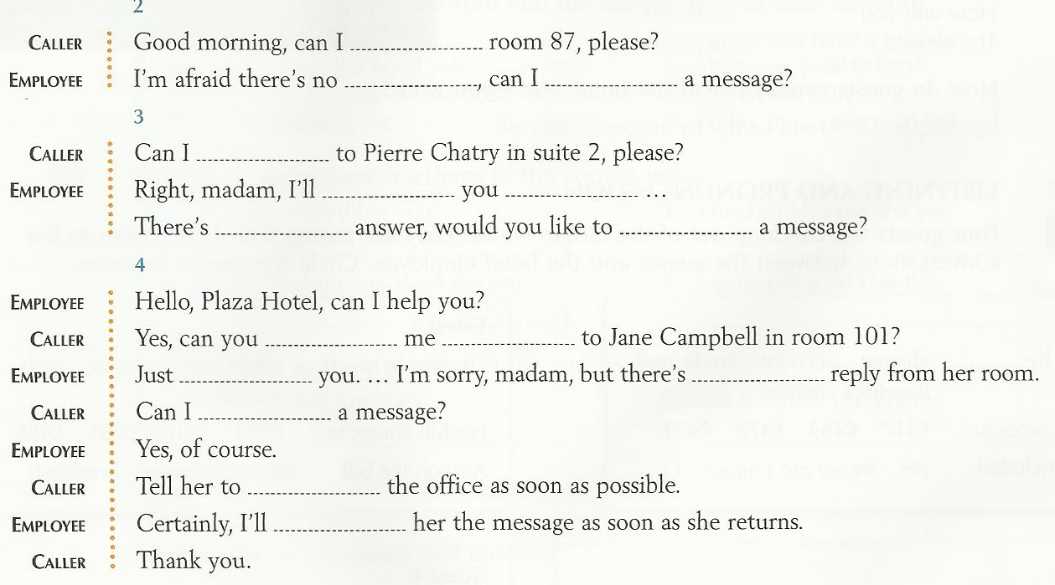

Slide 35
Personal Job File
Go to your job file.
Write down any new words and phrases.
Write down what an employee, answering the phone, would say in each of the situations.

Slide 36
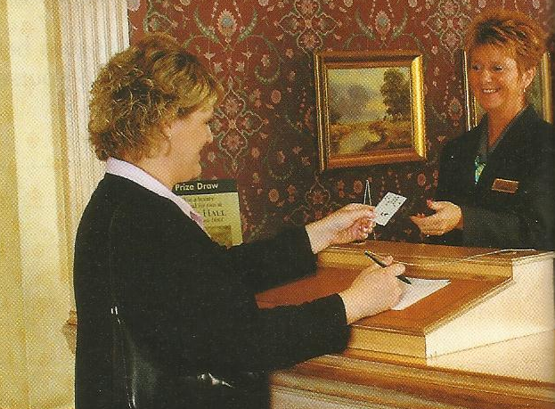
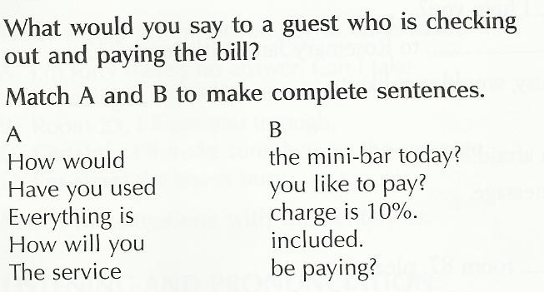
How would you like to pay?

Slide 37
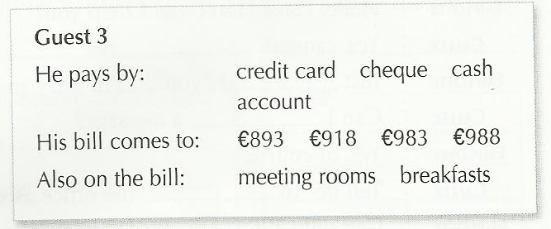
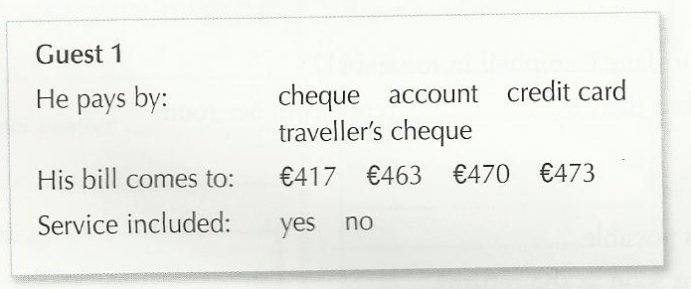
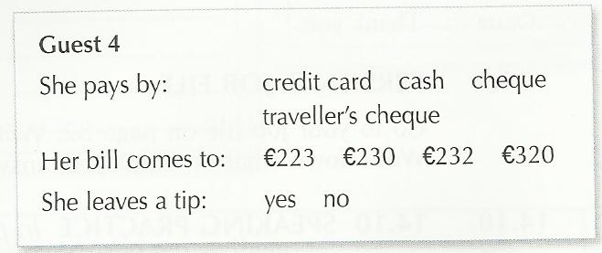
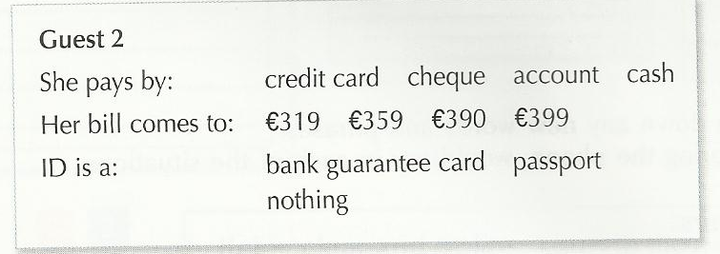

Slide 38
Being clear and polite listen to these sentences and repeat them.

Slide 39
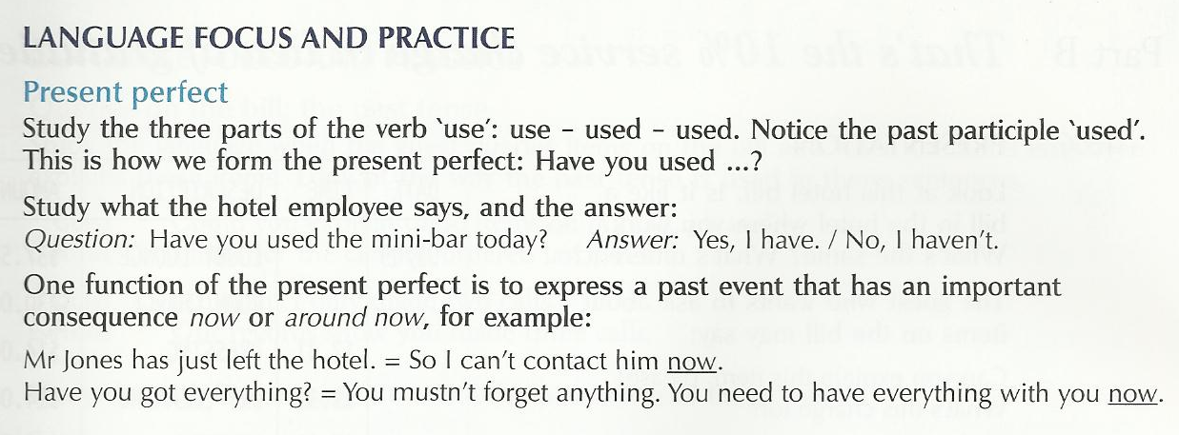

Slide 41
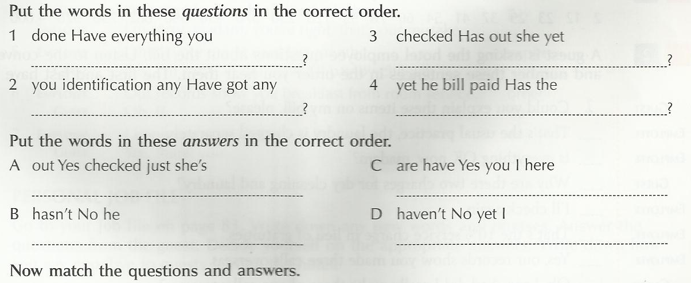

Slide 42
Personal Job File
Go to your job file.
Write down any new words and phrases.
Write the questions in exercise 1 and write the answers in exercise 2.

Slide 43
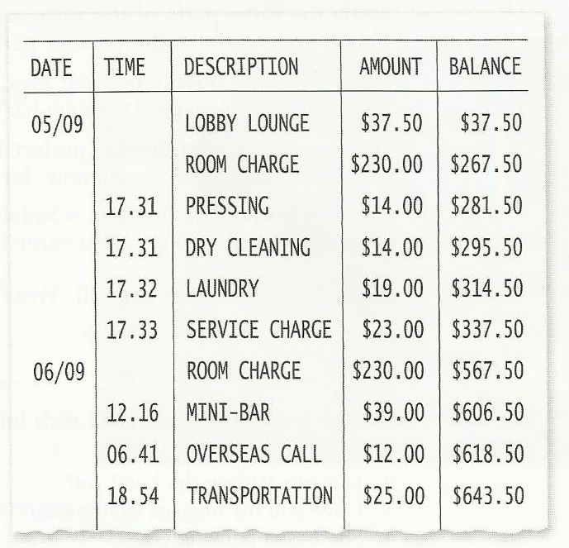
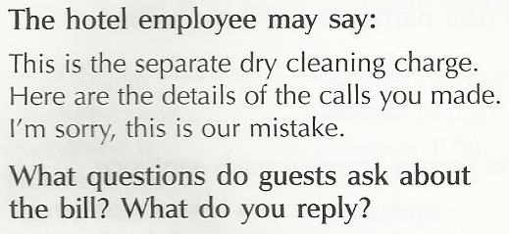

Slide 45
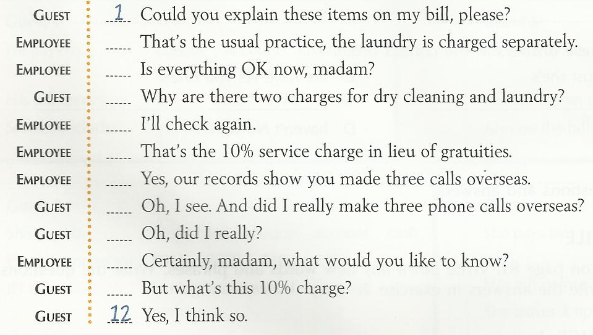

Slide 46
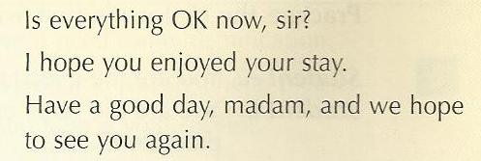
Being clear and polite listen to these sentences and repeat them.

Slide 47
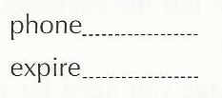

Slide 48
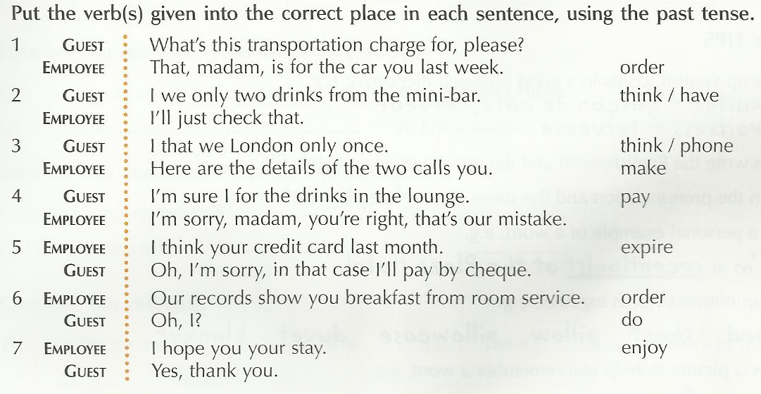

Slide 49
Personal Job File
Go to your job file.
Write down any new words and phrases.
Answer the questions from the guest.
Decide yourself on the appropriate answers.
Write down how you say goodbye to guests leaving the hotel.
I hope you enjoyed your stay.
Thank you for choosing our hotel.
Have a good trip.
Bon Voyage
Hope to see you next year.

Slide 50
We hope you enjoyed our course. Have a nice day.

